Slide 1
Capstone 2 Introduction
By Akiah Garland
09/17/2021

Slide 2
Role Playing Game: What is it?
A role playing game is a game “in which players assume the roles of characters in a fictional setting. Players take responsibility for acting out these roles within a narrative, either through literal acting, or through a process of structured decision-making regarding character development.” Wikipedia
Originally based on Table Top Games
Video games turned traditional parts of the game (dice rolling) into code
Modern RPGs expand into many different genres (Action, Strategy, etc.)

Slide 3
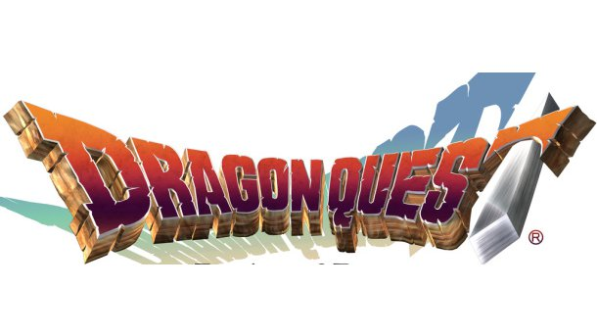


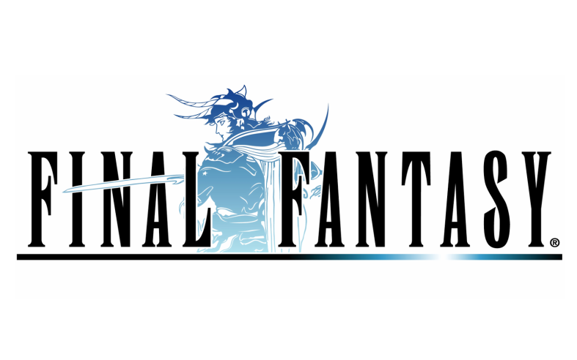

Notable Examples

